Slide 1

Orientation for
Prospective
New Members

Slide 2
PURPOSE OF ORIENTATION
To provide an introductory foundation to Lionism:
    Big picture of the Association.
    Perspective of Club functions.
    Understanding roles of new members.

Slide 3

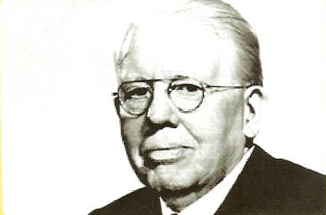
LIONS INTERNATIONAL
FOUNDER
Melvin Jones
Chicago -- 1917

Slide 4
LIONS INTERNATIONAL
MOTTO
We Serve
TAG LINE
Serving a world in need
HELEN KELLER’S CHALLENGE
“To become knights of the blind
in this crusade against darkness.”

Slide 5
LIONS INTERNATIONAL
STRUCTURE
Lions International
Lions Clubs International Lions Clubs International Foundation
Lions of Virginia District 24-L
Potomac Region
Zone F
Fredericksburg Host Lions Club

Slide 6
LIONS INTERNATIONAL
As Lions, we hold ourselves to the absolute highest standards
in everything we do.
Our members and clubs are dedicated to serving others,
and it shows.
We champion kindness in our communities and actively work
to improve the lives of all people.
MISSION
MISSION
Our mission is to empower Lions Clubs, volunteers, and partners
to improve health and well-being, strengthen communities,
and support those in need through humanitarian service
and grants that impact lives globally,
and to encourage peace and international understanding.

Slide 7
MEMBERSHIP
LIONS INTERNATIONAL
1.4 million men and women.
New goal is to reach 1.5 million.
Over 49,000 clubs.
Over 200 countries and geographical areas.

Slide 8
FAMILY & WOMEN
LIONS INTERNATIONAL
October 1917 Convention – Voted to admit women
1918 – Rescinded
1987 – Doors open to women Lions – again!
2008 – Focus on family, students,
and veteran members

Slide 9
LIONS INTERNATIONAL
FOCUS AREAS
Vision
Youth
Hunger
Disaster Relief
Humanitarian
Diabetes
Childhood Cancer
Environment
Additional Club Activities:
Eyeglass collection & recycling
Hearing screening
Volunteering at community events.

Slide 10

LIONS INTERNATIONAL
Charitable Arm of
Lions International
Disaster Relief
Grants to Clubs
Website: www.lcif.org
Donated $1.2B since 1968.
76 million volunteer hours each year.
Equivalent of more than 30,000
people working full time for a year.
Goal: Serve 200 million people per
year.

Slide 11

MULTIPLE DISTRICT 24
COMMONWEALTH OF VIRGINIA
District L
District C
District I

Slide 12

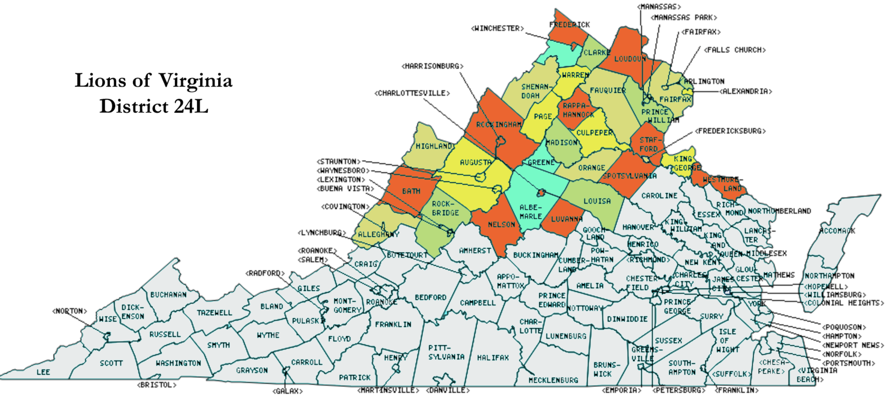
DISTRICT 24-L

Slide 13
DISTRICT 24-L
District Governor &
Cabinet
2-3 District Meetings & 1 State Convention
Website:
wwwvalions.org
70 Clubs
Zone F:
  Fredericksburg Host
  Greater Falls Run
  Stafford County
  Aquia Harbour Host
  Aquia Evening
  Westmoreland

Slide 14
FREDERICKSBURG HOST LIONS CLUB
Established November 24, 1938
Membership: 91 (as of 6-17-26)
Meetings:
          1st Wednesday – Planning
2nd Wednesday – Dinner - Ristorante Renato
2 Corporations: 501(c)(4) & 501(c)(3)
Family Events: Picnics, Charter Night, Installation, Holiday Party

Slide 15
FREDERICKSBURG HOST LIONS CLUB
2026-2027 OFFICERS & DIRECTORS
President: Aaron Hackett
Immediate Past President: Debe Fults
1st VP - Administration: David Cropper
2nd VP - Fundraising: Sally Cooney Anderson
3rd VP - Service: Glenda McBride
Secretary: Marie Knoxville
Treasurer: Sean Parman
Lion Tamer: Relda Larguet
Tail Twister: Ev Andrianos
Membership Director: Ken Lapin
LCIF Coordinator: Carol Byers
Directors: Caroline Burnett, Dawn Richards, Dena Cooke, Charles Hoskins

Slide 16
FREDERICKSBURG HOST LIONS CLUB
PRIMARY SERVICE ACTIVITIES
Vision & Hearing Screenings
Eyeglasses & Hearing Aids
Eyeglass Recycling
Diabetes Education
Youth & School Program Support, including Scholarships
Hunger Eradication
Financial and Volunteer Support for other Non-Profits
Flexibility in Service Activities
Donate more than $60,000 to our community each year

Slide 17
FREDERICKSBURG HOST LIONS CLUB
PRIMARY FUNDRAISING ACTIVITIES
Golf Tournament - Fall
Christmas Tree Sales - November/December
White House Christmas Ornaments – October-December
Reverse Raffle - Spring
Corporate & Individual Sponsors and Donors

Slide 18
FREDERICKSBURG HOST LIONS CLUB
EXPECTATIONS
Participation
  Serve on a Committee
  Engage in Service
  Support Fundraising
  Attend Meetings as often as possible

Slide 19
FREDERICKSBURG HOST LIONS CLUB
COST
Initiation: $35
Dues: $40 per quarter
Family and Student Discounts
Quarterly Bills
Meal Payment at Meetings

Slide 20
FREDERICKSBURG HOST LIONS CLUB
BENEFITS OF MEMBERSHIP
Satisfaction -- providing hands-on service to improve the lives of
members of our community.
Friendship -- enjoying fellowship with the finest men & women in
our community & worldwide.
Skills -- enhancing communication, leadership, & planning.
Networking, Travel, & Training
All while having fun!

Slide 21
"How wonderful it is that nobody need wait a single moment before starting to improve the world."
-- Anne Frank
"An idea is just a thought…
An idea with a Champion is a success!"
-- Unknown member of a nonprofit
“You must get involved to have an impact”
-- John H. Holcomb

Slide 22
QUESTIONS ?
Would you like a
Membership Application?

