Slide 1
New Member Orientation
<Club Name Here>
<Presenter>
<Date>
Notes:
Trainer Tip: Enter additional information as you see fit, such as the name of the New Member Orientation trainer. Use this PowerPoint along with the New Member Orientation Training Guide. Be sure each of your participants has a New Member Orientation Guide to follow along with the presentation.

Slide 2

New Member Orientation Summary
New member orientation is broken out into
four sections:
  Who Lions Are
  Lions Clubs International (LCI)
  District and Multiple District
  Your Club

Slide 3

Who Lions Are
Lions are men and women dedicated to serving those in need, whether in their own community or around the world.
  Almost 1.4 million members
  Over 200 countries
  More than 48,000 clubs

Slide 4
Who Lions Are
Vision Statement: To be the global leader in community and humanitarian service.
Mission Statement: To empower volunteers to serve their communities, meet humanitarian needs, encourage peace and promote international understanding through Lions clubs.
Motto: “We Serve”
Slogan: Liberty, Intelligence, Our Nation’s Safety
Purposes: LCI has a list of purposes to convey why Lions clubs exist.
Code of Ethics: LCI has a code of ethics which set the standard that Lions should aspire to adhere to.

Slide 5
Lions Clubs International

Slide 6
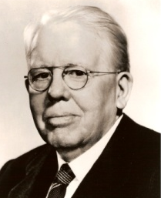
History
1917: Melvin Jones founded LCI.
1920: LCI becomes international with Canadian club.
1925: Helen Keller challenged Lions to become “knights of the blind.”
1945: LCI helped draft the United Nations Charter.
1957: The Leo Club Program is created.
1968: The Lions Clubs International Foundation is established.
1990: SightFirst is launched.
Today: Our international network has grown to include more than 200 countries and geographic areas.
1987: LCI became the first service club organization to admit women as members.

Slide 7
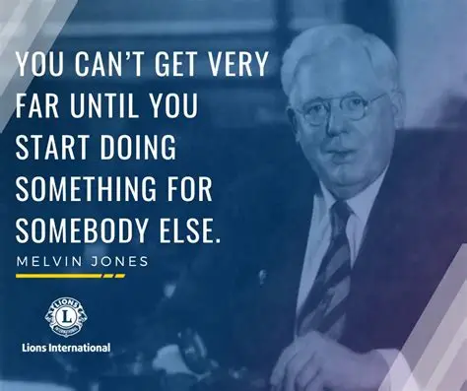
Melvin Jones - Founder

Slide 8

Helen Keller Challenge to Lions

Slide 9

Name and Logo
The official name of the association is “The International Association of Lions Clubs” or simply “Lions Clubs International.”
The name Lions was chosen on a secret ballot over several others because the lion stood for strength, courage, fidelity and vital action.
The Lions logo consists of a gold “L” on a blue field surrounded by a gold circle. On either side of the circle is the profile of a Lion’s head, one looking back upon a proud past and the other looking optimistically toward the future.

Slide 10
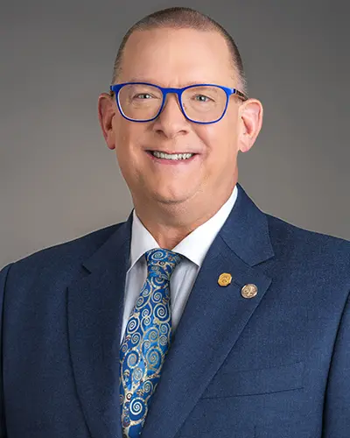
Organizational Structure
International officers implement policy and serve as inspirational leaders of the world’s Lions.
  International President: Mark Lyon
  First Vice President: Dr. Manoj Shah
  Second Vice President: Tony Benbow
  Third Vice President: C. Robert Rettby
  Immediate Past President/LCIF Chairperson: A.P. Singh
The International Board of Directors is the governing body of the association.
  34 members
The International Constitution and By-Laws govern the operations of the association and establish the rules by which the association is to function.

Slide 11

International President Mark Lyon’s Theme

Slide 12
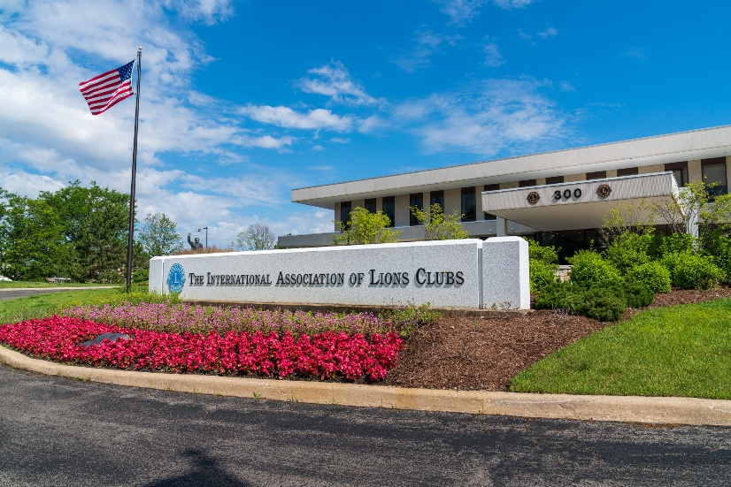
International Headquarters
Located in Oak Brook Illinois
Approximately 275 staff members
in 11 divisions:
  Club Supplies and Distribution
  Convention
  District and Club Administration
  Executive Services
  Extension and Membership
  Finance
  Information Technology
  International Activities and Program Development
  Leadership
  Legal
  Public Relations and Production

Slide 13
Lions Clubs International Foundation (LCIF)
Important Facts
  Founded in 1968: official foundation of Lions Clubs International, empowering the service of Lions
  Provides grant funding for large-scale humanitarian projects
  Relies on donations
  More than US$1.3 billion in grants awarded to date
  Amidst the most ambitious fundraising campaign in its history

Slide 14
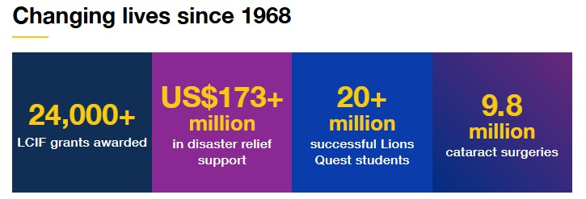
Lions Clubs International Foundation (LCIF)

Slide 15
Leadership
LCI provides training and development opportunities for Lions. The Global Leadership Team (GLT) is the driving force behind these programs, including:
  Emerging Lions Leadership Institutes
  Faculty Development Institutes
  Regional Lions Leadership Institutes
  District Governors-Elect Seminar
  Multiple District Leadership Development Funding
  GLT District Funding Support Program
  Webinars
  Lions Learning Center
  Lions Certified Instructor Program

Slide 16

Service Activities
Because Lions seek to address the greatest needs in their communities, our activities are varied, although Lions are united behind eight global causes. The Global Service Team (GST) is the driving force behind these programs and collects and shares service stories that empower leaders to act.

Slide 17
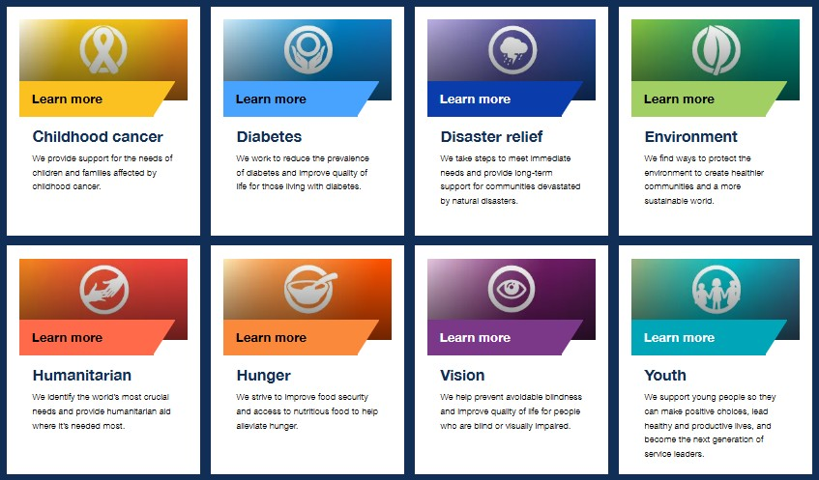
Our Global Causes

Slide 18
Membership Development
Recruiting new members into your club ensures that there will be a continual influx of enthusiastic members to serve those in need and identify new service that can be done in your community. Membership programs designed to help stimulate growth and foster quality members include:
  Family Membership
  Student Membership
  Leo to Lion
  Lions Worldwide Induction Day
  Leo Clubs
  Club Branches
In addition, forming new clubs is essential to serving a new or underserved area. Membership has several club types to help every member find the right fit:
  Traditional Lions clubs
  Campus Lions clubs
  Leo Lions clubs
  Lioness Lions clubs
  Specialty Lions clubs

Slide 19
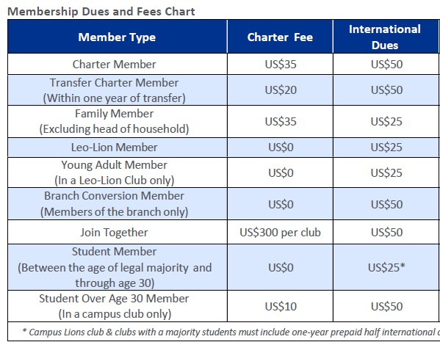
Membership LCI Dues and Fees

Slide 20
International Convention
Convention brings together thousands of Lions from around the world for a week of business, education, celebration and fellowship.
2027 Washington DC – July 2-6
2028 Singapore - June 23-27
2029 Minneapolis, MN – June 29-July 3
2030 San Antonio TX – June 28-July 2
2031 Helsinki Finland – July 4-8
To learn more about the upcoming LCI Convention – please visit LionsCon27 — International Lions Convention 2027 Washington D.C.

Slide 21

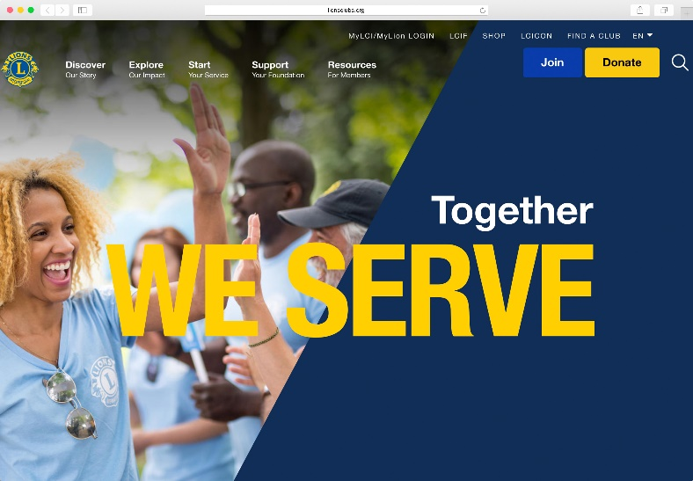
Communications
LION Magazine
E-mail Messages
Website
  lionsclubs.org
Social Networking
  Facebook
    facebook.com/lionsclubs
  Twitter
    twitter.com/lionsclubs
  YouTube
    youtube.com/lionsclubs

Slide 22
District and Multiple District

Slide 23
Organizational Structure
We are in Constitutional Area 1 (United States and Affiliates)
There about 750 districts with 35 or more clubs and at least 1,250 members in each district.
  Each district has a district governor
Multiple districts are formed by two or more districts within a territory.
Our Multiple District: MD 24 (Virginia)
Our District: 24-L
Your Zone: <Place Zone Here>
Notes:
Trainer Tip: Consider adding additional information about your district and multiple district, such as boundaries of your district and multiple district.

Slide 24
District Leadership
District Governor: Chuck Schwab, Broadway Lions
First Vice District Governor: Greg Derosa, Fairfax Host Lions
Second Vice District Governor: Mark Larsen, Stafford County Lions
Cabinet Secretary-Treasurer: Vicki Davies, Stephens City Lions
Cabinet Treasurer: Thomas Rachele, Montclair Lions
Zone Chairperson: Regan McLaughlin, Falls Church-Annandale Lions
Council of Governors: CC Beth Stevens, DG 24I Sheila Chewning, DG 24C – Babette Newman
Global Action Team:
  Global Action Team District Chairperson (District Governor): Chuck Schwab, Broadway
  Global Membership Team District Coordinator: David Cropper, Fredericksburg Host
  Global Leadership Team District Coordinator: Don Bradley, Burke
  Global Service Team District Coordinator: Evelyn Marr, Montclair
  Global Extension Team District Coordinator: Glen Logan, Alexandria Asian-American
  Lions Club International Foundation District Coordinator: Shirey Gorospe, Springfield Global
Notes:
Trainer Tip: Briefly go over the roles of each of these positions. The roles are found in the trainer and participant’s guide.

Slide 25
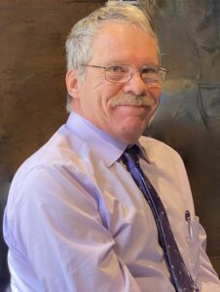
District Governor Theme
DARE TO… This theme will evolve throughout the year with a different word added to this phrase, providing a fresh lens through which we can view our mission and our impact. It is an invitation to remain curious, to stay bold, and to constantly challenge the boundaries of what we can achieve for our local communities and the world.

Slide 26
District Conventions
District conventions are held to:
  Develop fellowship among the Lions of the district
  Conduct general district business
  Elect the district governor and other district-elected officers
  Conduct seminars
District 24-L Fall Conference – September 19th, 2026 at Weyers Cave
District 24-L Winter Conference – January 30th, 2027 at Winchester
MD-24 State Convention – May 27-30th, 2027 at Harrisonburg

Slide 27
How the District and Multiple District Communicate
Lions of Virginia Website - https://www.e-district.org/sites/md24/
District 24-L Website – www.valions.org
District 24-L Facebook Page - https://www.facebook.com/search/top?q=virginia%20lions%20-%20district%2024-l
District 24-L Instagram - https://www.instagram.com/virgina_lions_24l/
District 24-L LinkedIn - https://www.linkedin.com/groups/4525259/

Slide 28
<Club Name Here>
<Club Logo Here
(if have one)>

Slide 29
History
Year chartered: <Charter Date>
Number of members: <Number>
Sponsored by: <Sponsor>
Notes:
Trainer Tip: Edit this slide as you see fit. Remove things that don’t apply to your club, or add things that are not currently included.

Slide 30
What is the Club known for in the Community
<Enter Signature Projects>

Slide 31

Service and Fundraising Activities
<Club Fundraisers>
<Club Service Projects>
What is your Passion?
Notes:
Trainer Tip: Consider adding photos from the projects to the slide if they are available.

Slide 32
Club Officers
President: <Name>
Secretary: <Name>
Treasurer: <Name>
Vice Presidents <Name(s)>
Membership Chairperson: <Name>
Marketing Communication Chairperson: <Name>
Service Chairperson: <Name>
Directors: <Name>
Lion Tamer: <Name>
Tail Twister: <Name>
Club Administrator: <Name>
Guiding Lions: <Name for New Clubs>
Notes:
Trainer Tip: Add the names of the current club officers. Add or remove bullet points if your club has different officers than those listed.

Slide 33
Elections
Officers are elected annually
Club president appoints a nomination committee in March
The nomination committee selects candidates
Notice of election shall published to each member 14 days before the election
Club members hold elections for upcoming terms in April
Secretary reports the new officers in the Lions Portal by May 15th
The term begins July 1st

Slide 34
Membership
The benefits of Lions club membership are numerous,
and include:
Be part of a global community for good
Doing something you are passionate about to help your community
Support, tools and resources to enhance your service
Leadership development opportunities
The satisfaction and joy of helping those in need
Networking opportunities with local and international community leaders
Friendship and fellowship with service minded people
Respect and credibility of being a Lion

Slide 35
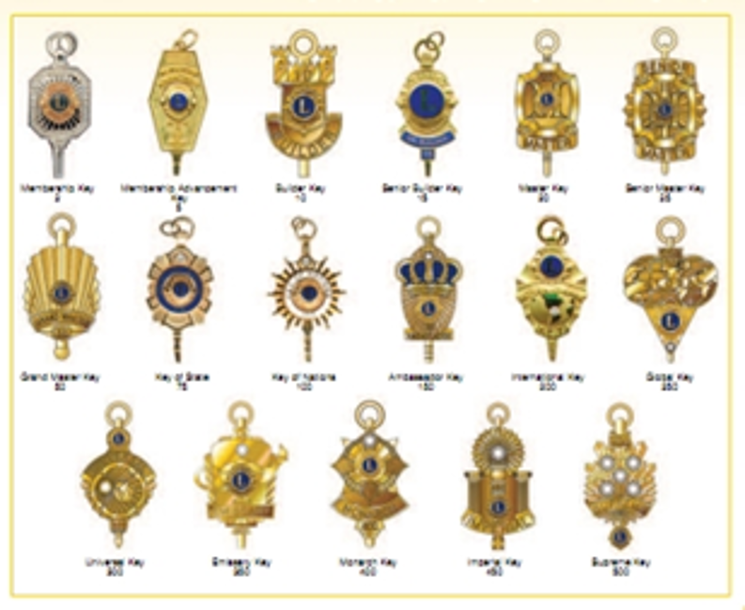
Awards
While service is its own reward, special accomplishments and milestones should be recognized and celebrated. The awards below are awards that all Lions can achieve.
Membership Keys
Chevrons
Member Sponsor Recognition
Extension Awards
Notes:
Trainer Tip: Add additional information to this slide to show additional awards that are available through your club, district or multiple district.

Slide 36
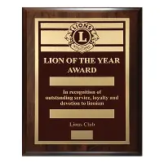

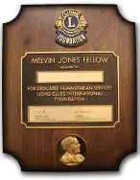
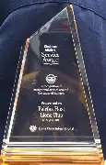
Celebrating Service
Member Awards – Lion of the Year, Melvin Jones Fellow
Club Awards – Club Excellence, Kindness Matters
https://lionsuniversity.org/wp-content/uploads/Art-of-Recognition.pdf
2025-2026 District 24-L Club Officers Workshops

Slide 37
Meetings
When: <Date and Time>
Where: <Location>
Notes:
Trainer Tip: Add any additional meeting information you feel is important.

Slide 38
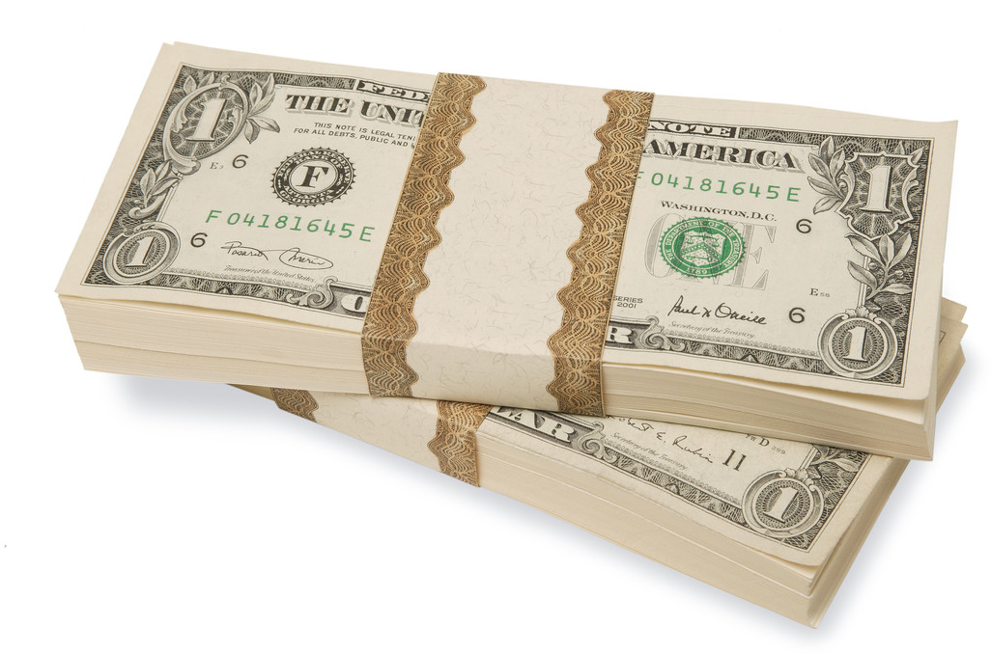
Dues and Budgets
Total Dues
  Club dues: <Amount>
  District and multiple district dues:
    US$16 a year per member
    Billed once a year – Nov 1st
    Due by Nov 30th
  International dues:
    US$50 a year per member (certain membership categories are $25 per year)
    Billed twice a year - July 1st and Jan 1st
    Due within 60 days
Activities Budget
Administrative Budget
Notes:
Trainer Tip: Explain that the activities budget consists of funds raised form the public through club projects and may only be expended to satisfy a community or public need. The administrative budget is what finances club operations and comes mostly from club dues.

Slide 39
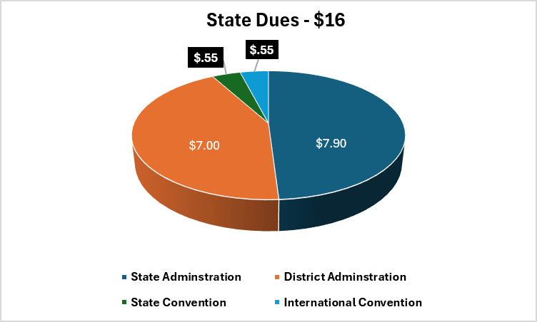
State Dues Breakdown

Slide 40
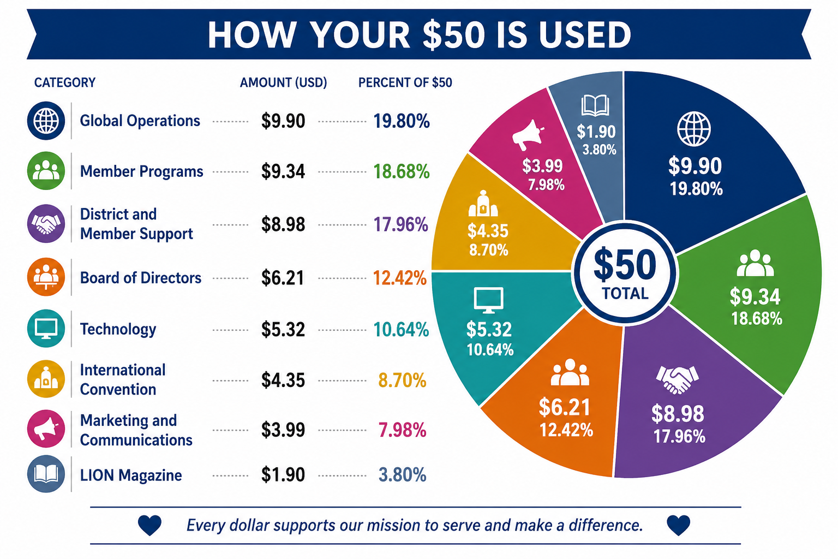
International Dues Breakdown

Slide 41
How We Communicate
[List all forms of club communication including newsletters, e-mails, Facebook page, website etc.]
<Add Club Links>
What would you like to do?

Slide 42
Welcome to our Lions Club!
Any Questions?

Slide 43
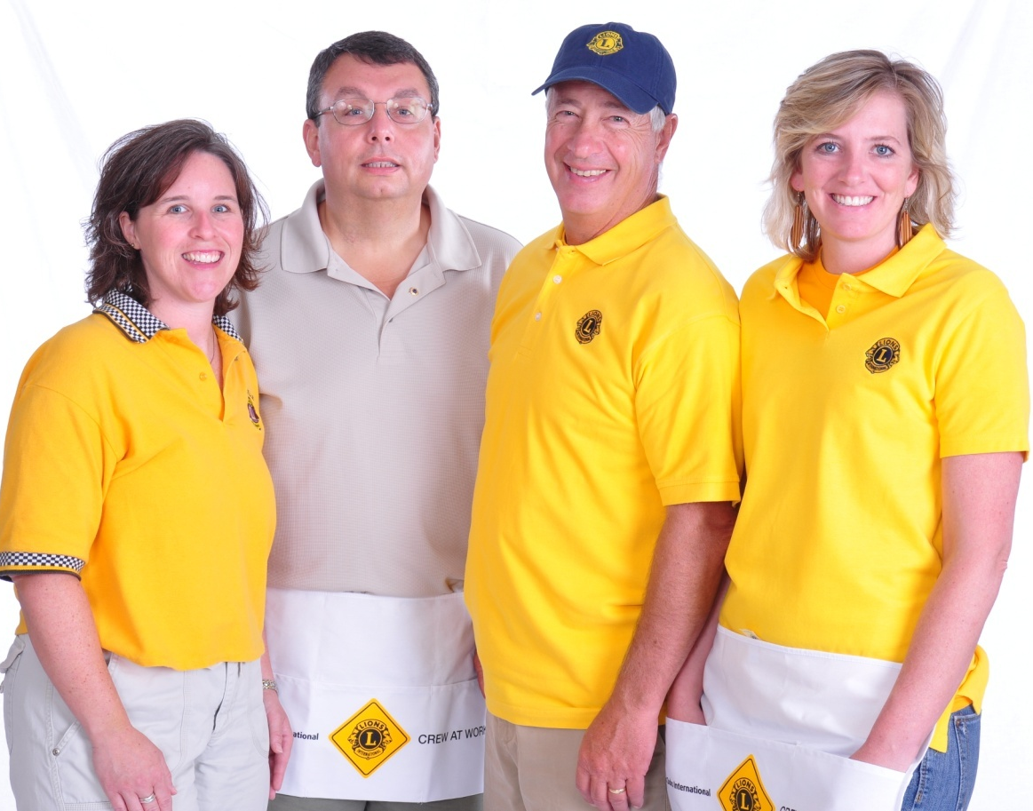
Lion Title Abbreviations
LCI: Lions Clubs International
LCIF: LCI Foundation
IP: International President
PIP: Past International President
ID: International Director
PID: Past International Director
MD: Multiple District (Texas has 16 districts)
CC: Council Chair (MD Council of Governors Chair)
1st VP: First Vice President
2nd VP: Second Vice President
DG: District Governor
IPDG: Immediate District Governor
PDG: Past District Governor
GST: Global Service Team
GMT: Global Membership Team
GLT: Global Leadership Team
GET: Global Extension Team
CT: District Cabinet Treasurer
CS: District Cabinet Secretary
RC: Region Chairperson
ZC: Zone Chairperson

