Slide 1


Join US as We Serve those in need.
More Lions = More Service
Club Membership Chair Workshop:
Membership Matters
Lion David Cropper, District 24-L Global Membership Team Chair
August 26, 2026

Slide 2

“There is only one thing greater than having the privilege of being a member of the Lions Club and that is helping to build one” –
Melvin Jones

Slide 3

Welcome Club Membership Chairs!
Icebreaker:
“One thing I love about being a Lion is …..”

Slide 4

Importance of Increasing Members
(Strengthening our capacity to serve, grow, and make a positive difference in the lives of those We Serve)
Expanded Community Impact
Diverse Skillsets and Resources
Broader Network and Influence
Financial Sustainability
Long-Term Viability
Enhanced Member Engagement
Increased Public Awareness
Notes:
Expanded Community Impact: With more members, the Lions Club can undertake larger projects, reach more people in need, and make a greater impact on the community.
Diverse Skillsets and Resources: Each new member brings unique skills, experiences, and resources to the club, enriching its capabilities and increasing its effectiveness in serving the community.
Broader Network and Influence: A larger membership base means a wider network of connections within the community, which can open doors to new partnerships, collaborations, and opportunities for growth.
Financial Sustainability: More members mean a larger pool of dues and donations, providing the club with greater financial stability to support its initiatives and maintain its operations.
Long-Term Viability: By attracting new members, the club ensures its continued relevance and sustainability for future generations, safeguarding its ability to serve the community for years to come.
Enhanced Member Engagement: A vibrant and growing membership fosters a sense of belonging and engagement among members, leading to increased participation, creativity, and satisfaction within the club.
Increased Public Awareness: A larger membership base increases the club's visibility in the community, raising awareness of its mission, activities, and impact, which can attract more support and involvement from the public.

Slide 5
What Does a Healthy Club Look Like
1. Friendly club meetings
2. Gets new members involved immediately
3. Members work well together and enjoy being with each other
4. Has motivated, enthusiastic, and caring leadership
5. Involve members in planning and service
6. Has goals that are reviewed and adjusted regularly
7. Publicizes service projects pre and post
8. It is not run by the same Lions year after year
9. Is diverse in gender, age, race, and ethnicity
10. Financially healthy with all dues and expenses paid on time

Slide 6
What Does a Successful Club Look Like?
1. Members know and appreciate each other
2. Members have fun in meetings, activities, service projects, and fundraisers
3. Constantly changing and trying to achieve excellence in meetings and projects
4. Takes intentional steps to stay healthy
5. Visible and known in the community
6. Makes a difference in the community
7. Stable membership
8. Conducts multiple service projects
9. It has members that participate in the zone, region, district, state, and
international activities

Slide 7
Why Members Leave
Boring
Lack of Caring, compassion, and concern
Cliques form
Club members got older and did no recruiting
Club officer manipulation
Lack of commitment
Lack of dedication
Lack of diversification
Lack of interest
Lack of leadership
Lack of service
The community is too small to support a club
They need to encourage members to go to meetings beyond the local club
Wrong reasons for starting a club or becoming a club officer
Lack of training
Lost heart, mission, and purpose
Members stop enjoying being Lions. Cease to have fun serving, to enjoy meetings, and projects, no benefit to what the club is doing in the community.
Naysayers/negative members
No fun, too much time focusing on details
No good programs for meetings
No meaningful projects to keep members interested
Stagnation
Stubborn members

Slide 8

Lions Year 2026-2027 Targets*
DISTRICT | NEW CLUBS | NEW MEMBERS | NET
24 L | 2 | 350 | 4
24 C | 2 | 177 | 18
24 I | 2 | 251 | 27
* For 2025 -2026: 24L – 1 New Club, 326 New Members, Net of 10
8
Notes:
MISSION 1.5 is the drive to reach 1.5 million Lion members worldwide on June 30, 2027, so we can better meet the growing needs of our communities and serve more than a billion people annually.
Membership goal and objectives are:
All CAs achieve positive net growth no later than FY 2026-2027.
All districts will add new clubs.
All clubs will induct new members during MISSION 1.5.
Districts incorporate strategies to attract a more diverse membership, including women and young Lions.

Slide 9
2026-2027 District 24L Membership Goals
1. Increase overall Membership by 2 Clubs & Net 4 members
Recruitment Drives – Community Outreach – Member referral
Improve Retention of Current members
Member Engagement - Mentorship Programs - Recognition and Awards
Attract and Develop Young Leaders
Youth Programs - Leadership Opportunities - Scholarships and Grants
Enhance a more Inclusive Environment
Recruitment Materials - Partnerships w/ broader audience – Workshops
Leverage Technology for Recruitment and Engagement
Online Presence - Virtual Events - Membership Software
Our membership efforts should continue to focus on an integrated program of our Community Service, Leadership Development, and Fellowship.
Notes:
Increase overall Membership by 2 Clubs & Net 4 within the next year.
Recruits active younger members to ensure the long-term sustainability of the club.
Establish partnerships with local organizations or colleges to attract students and young professionals.
Host community events to raise awareness about the club and its initiatives, aiming to recruit new members.
Implement mentorship programs to engage new members and help them integrate into the club.
Enhance member satisfaction through regular feedback surveys and implementing suggestions for improvement.
Provide leadership training opportunities for members to develop their skills and take on active roles within the club.
Collaborate with other local organizations and businesses to expand the club's network and potential membership pool.
Develop a robust online presence through social media and a user-friendly website to attract tech-savvy individuals.
Celebrate milestones and achievements within the club to foster a sense of belonging and pride among members, encouraging them to recruit others.

Slide 10
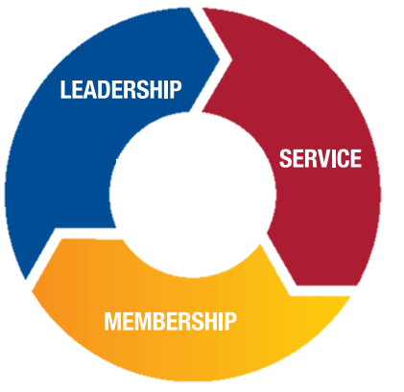

The Global Action Team (GAT) helps districts and clubs achieve their goals by creating a unified approach to all key areas of Lions.
A Unified Approach
The Global Membership Team (GMT) will support membership development at the club level by recruiting new members and promoting positive membership experiences. At the district level, the GMT will work with the GET to start clubs in new areas to further increase our service impact. More members = more hands for service.

Slide 11
Membership Chair Roles & Responsibilities
Key Roles: Membership Chair
Develop a membership growth plan
Develop a membership retention plan
Develop a successful onboarding plan for each new member
Work with secretary to ensure new membership kits are ordered at the beginning of the Lion Year
Ensure membership kits are prepared for member induction
Attend Membership Chair Training or take virtually
Work with District GMT and GET as required
Look at leveraging AI for recruitment

Slide 12
Building Your Membership Action Plan
Set a SMART goal
      - e.g., Add 5 new members & achieve 95 % retention by 30 Jun 2026
          Define two strategic actions
          - Host a “Serve & See” hands-on service day
          - Launch a referral incentive: “Bring a Friend, Plant a Tree”
Pinpoint one community need your plan will address
Assign roles & timeline
Measure & celebrate success milestones
“What gets celebrated gets repeated.”

Slide 13
What Are SMART Goals?
Specific: Increase new membership by 5 within the next 12 months.
Measurable: Track the number of new members joining the club each month and compare it to the baseline membership count at the beginning of the 12-month period.
Achievable: Implement targeted recruitment strategies, such as digital marketing campaigns, community outreach events, and referral programs, to attract potential members. Ensure that adequate resources and support are allocated to support recruitment efforts.
Relevant: Increasing new membership aligns with the club's overall goal of expanding its reach, impact, and sustainability. By bringing in new members, the club can enhance its capacity to serve the community and achieve its mission more effectively.
Time-bound: The goal is to achieve a Net 10% increase in new membership within the next 12 months, providing a clear timeframe for implementation and evaluation of recruitment efforts.
Our overall SMART goal for new membership, will us to focus our efforts, track progress, and take actionable
steps to attract and retain new members, ultimately contributing to the club's growth and success.

Slide 14
Ideas for Developing a Membership Plan (1 of 2)
Define Membership Tiers
Promotional Campaigns
Engagement Initiatives
Youth Outreach
Member Referral Program
Corporate Partnerships
Flexible Meeting Schedules
Notes:
Define Membership Tiers: Create different membership levels based on commitment levels or benefits offered, providing options for various interests and availability.
Promotional Campaigns: Develop targeted campaigns through social media, local newspapers, and community bulletin boards to showcase the value of Lions Club membership.
Engagement Initiatives: Plan regular events, both in-person and virtual, to engage current and potential members, fostering a sense of community and camaraderie.
Youth Outreach: Collaborate with schools and colleges to establish Leo Clubs, encouraging younger members to join and contribute to community service.
Member Referral Program: Incentivize existing members to recruit new ones through a referral program, offering recognition, awards, or other benefits.
Corporate Partnerships: Establish partnerships with local businesses to promote Lions Club membership as part of their corporate social responsibility efforts.
Flexible Meeting Schedules: Accommodate varying schedules by offering both daytime and evening meetings, allowing more individuals to participate.

Slide 15
Ideas for Developing a Membership Plan (2 of 2)
Training and Development
Recognition Program
Community Collaborations
Testimonials and Success Stories
Diversity and Inclusion
Member Feedback Mechanism
Continuous Promotion
Notes:
Training and Development: Provide ongoing training and skill development opportunities, making membership more enriching and attractive.
Recognition Program: Acknowledge and celebrate member achievements, milestones, and contributions to create a positive and inclusive club culture.
Community Collaborations: Forge alliances with other community organizations to expand outreach and jointly address local needs.
Testimonials and Success Stories: Share testimonials from existing members and highlight success stories to inspire and attract new individuals to join.
Diversity and Inclusion: Promote a diverse and inclusive environment, ensuring that the Lions Club is welcoming to individuals from all backgrounds and demographics.
Member Feedback Mechanism: Establish a feedback system to understand member needs, concerns, and suggestions, actively incorporating input to improve the membership experience.
Continuous Promotion: Maintain a consistent presence in the community through ongoing promotional efforts to keep the Lions Club top of mind for potential members.

Slide 16
Fulfilling and rewarding experience that allows you to give back to your community, connect with others, and make a meaningful difference in the world.
What is in it for Me?
Community Impact
Networking Opportunities
Personal Growth
Social Connections
Recognition and Awards
Training and Development
Access to Resources
Global Impact
Sense of Purpose
Notes:
Community Impact: Being part of the Lions Club allows you to directly contribute to improving your community through various service projects and initiatives.
Networking Opportunities: You'll have the chance to connect with like-minded individuals, local leaders, and professionals from diverse backgrounds, expanding your personal and professional network.
Personal Growth: Engaging in volunteer activities, leadership roles, and skill-building opportunities within the club can lead to personal growth, development, and a sense of fulfillment.
Social Connections: Lions Club meetings, events, and activities provide opportunities for social interaction, camaraderie, and forming meaningful friendships with fellow members.
Recognition and Awards: Your contributions and achievements within the club may be recognized and celebrated through awards, honors, and leadership opportunities.
Training and Development: The Lions Club offers various training programs, workshops, and resources to help you enhance your leadership skills, expand your knowledge, and become a more effective community leader.
Access to Resources: Through the Lions Club network, you may gain access to resources, expertise, and support to address community needs and implement impactful projects.
Global Impact: As part of an international organization, you'll have the opportunity to contribute to global causes and participate in international service projects, making a difference beyond your local community.
Sense of Purpose: Being a Lions Club member provides a sense of purpose and fulfillment by actively participating in meaningful service activities and making a positive impact on the lives of others.

Slide 17
SWOT
Helpful
Harmful
Strengths
Established Brand: Strong Reputation for Community service and philanthropy
Diverse Membership: various backgrounds, professions, cultural, etc.
Existing Infrastructure: Structure and resources to support recruitment and retention.
Strong Community Ties
Weaknesses
Aging Membership Demographics: Struggle to attract younger members will hinder long-term sustainability.
Limited Outreach: Difficulty reaching potential members outside networks or geographic areas
Membership Turnover: High turnover
Limited Resources: financial and Human Resources are limited.
Internal
Opportunities
Collaboration with other organizations.
Digital outreach: utilizing social media, online advertisings, and website.
Targeted recruitment efforts: identify groups or communities that are underrepresented.
Leadership development: provide training and opportunities for personal and professional growth.
Threats
Competition from other organizations
Changing demographics: shifting demographics and social trends
Economic challenges: financial instability may limit ability to join.
Public perception: misconceptions about the organization
External

Slide 18
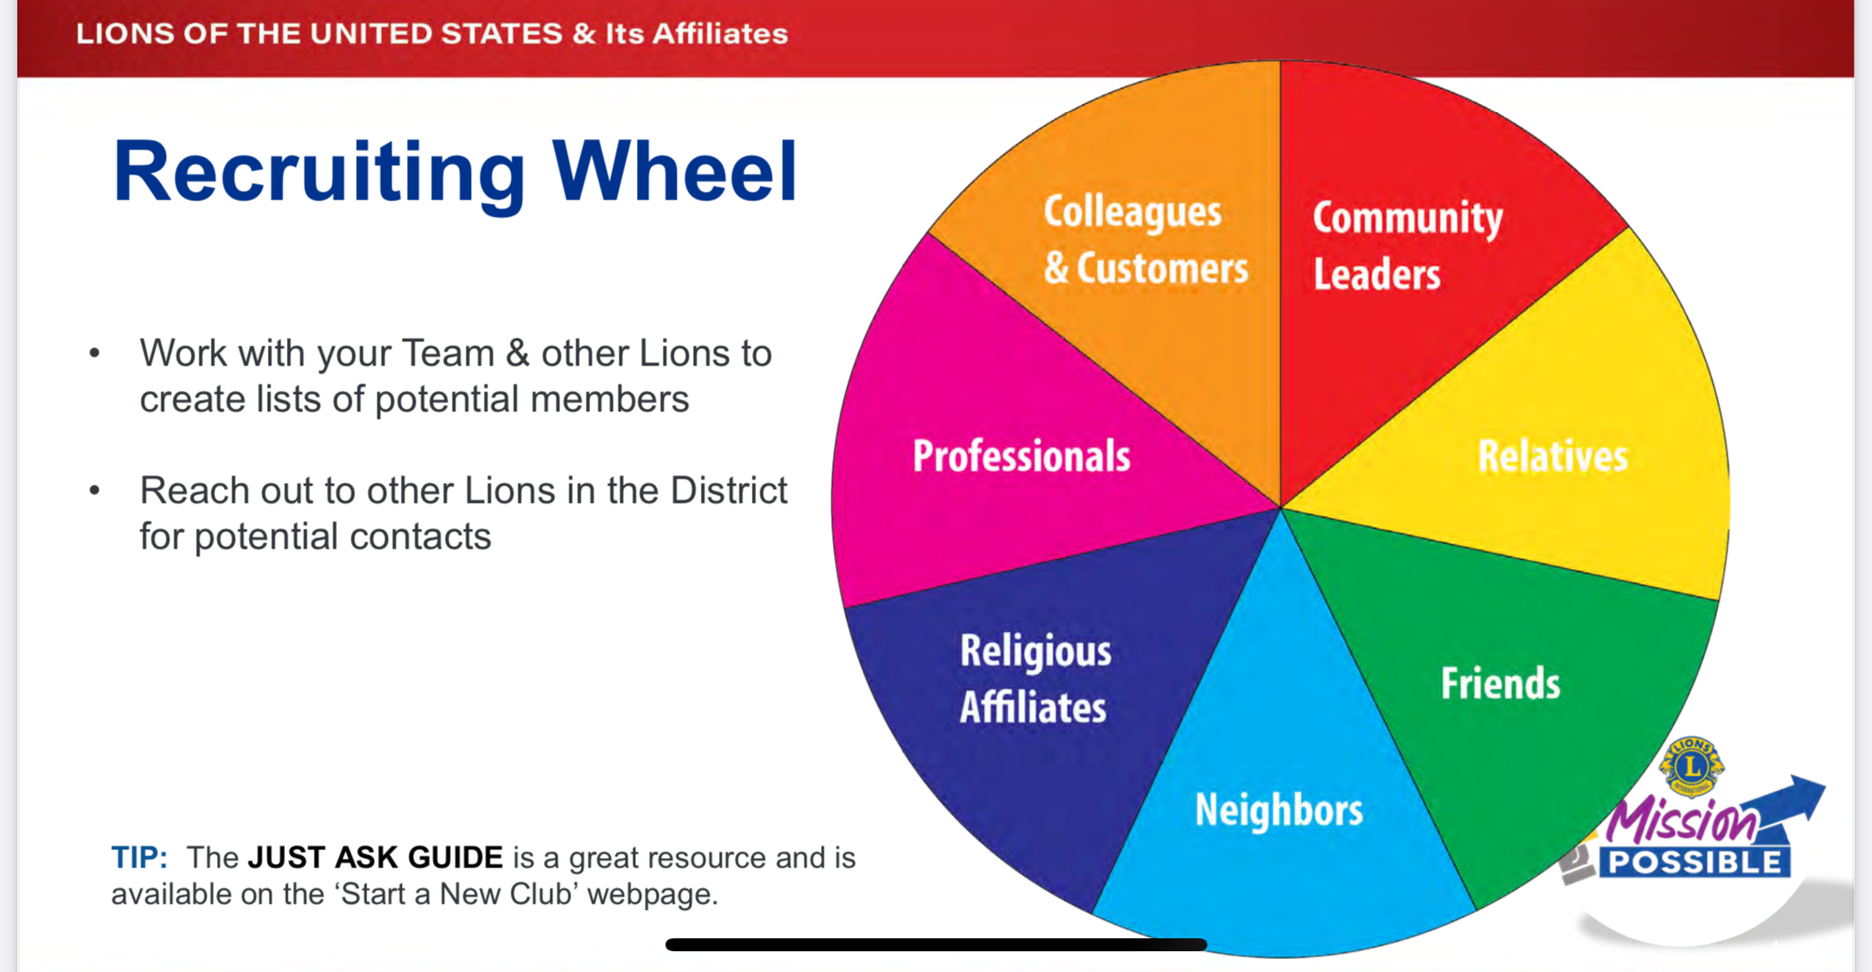

Slide 19
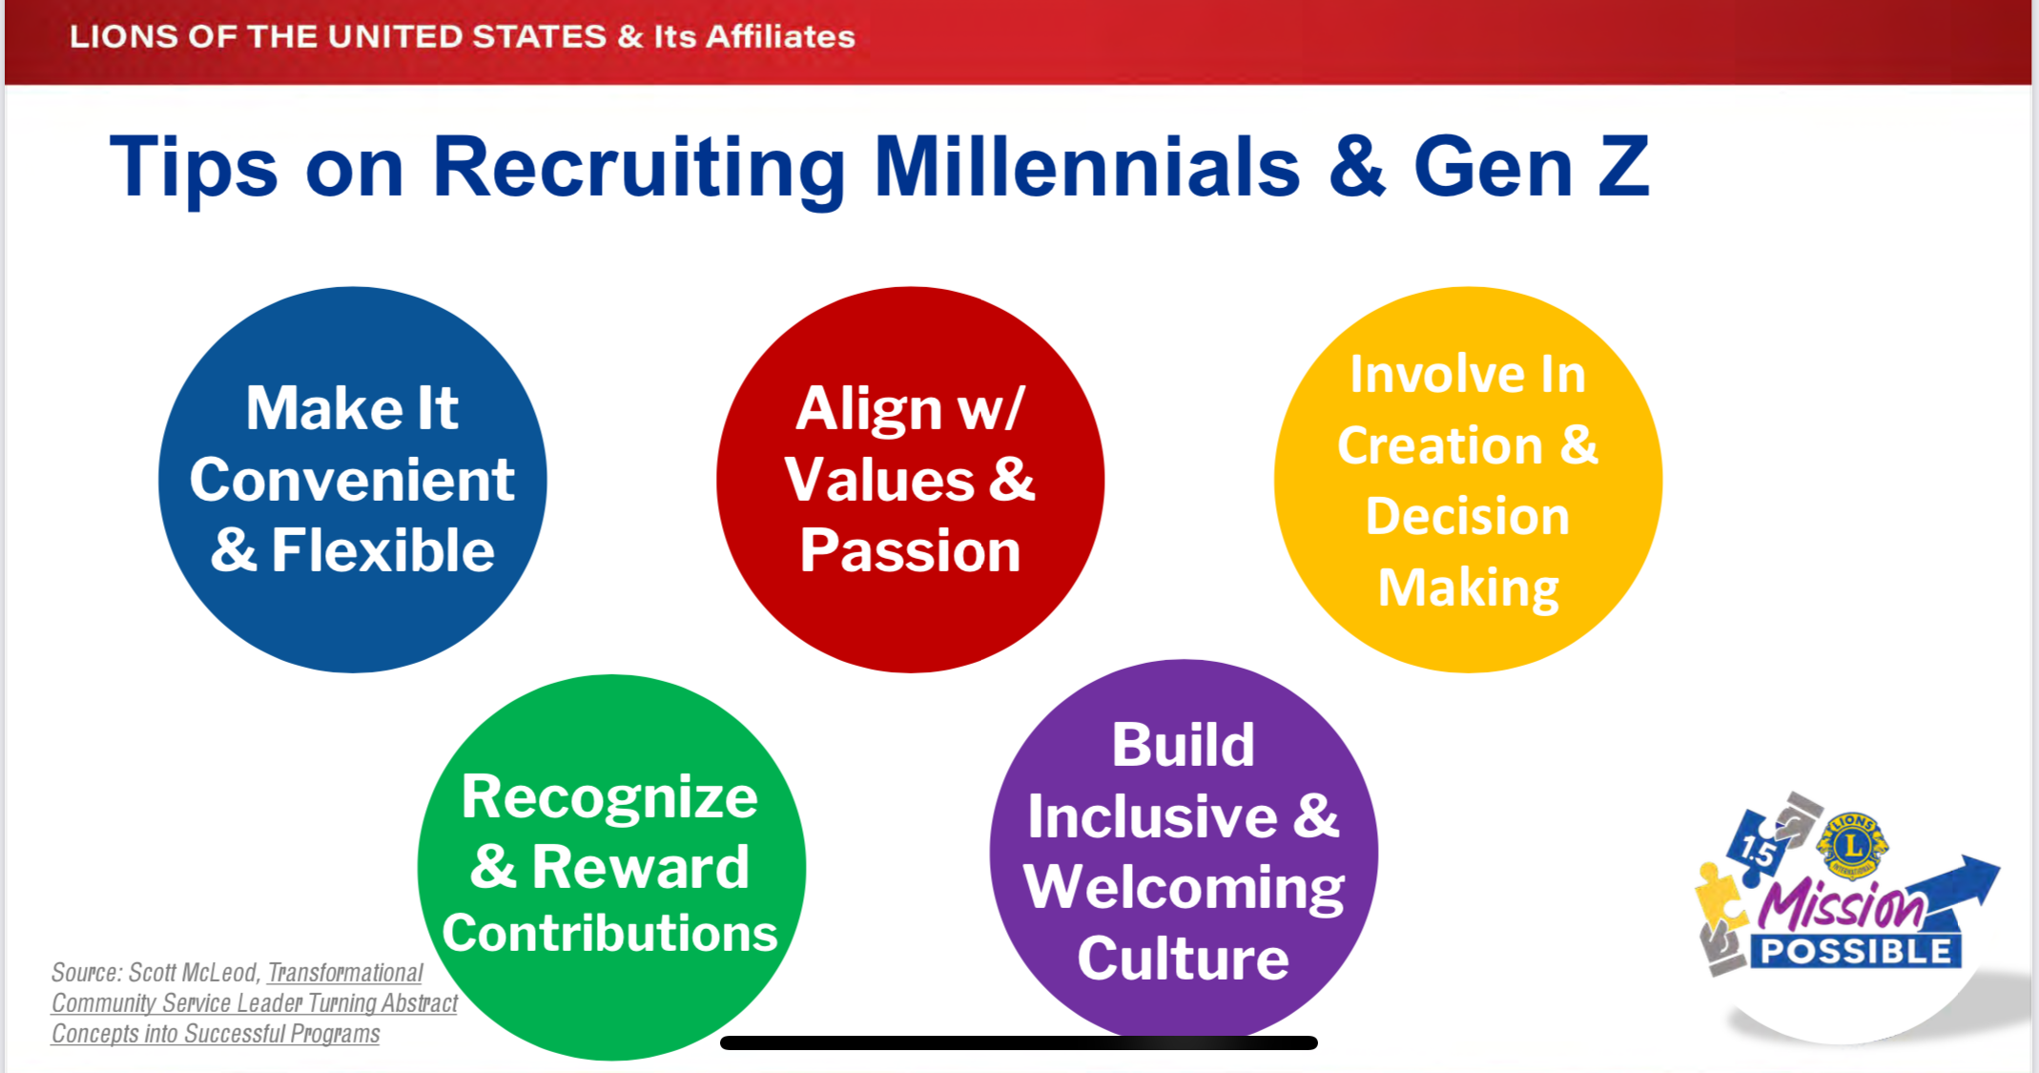

Slide 20
Other Considerations
Elevator Pitch – what to focus on
What You Can, When You Can, For Whomever You Can – tie to person’s passion
District will help with:
                Onboarding Checklist
New Member Orientation
AI Support – ChatGPT
Brochure and Business Card Templates
Curated Website, Facebook Page, and Instagram to help tell your story
Participate in District-Wide Membership Contest – Each One, Bring One
Notes:
Community Impact: Being part of the Lions Club allows you to directly contribute to improving your community through various service projects and initiatives.
Networking Opportunities: You'll have the chance to connect with like-minded individuals, local leaders, and professionals from diverse backgrounds, expanding your personal and professional network.
Personal Growth: Engaging in volunteer activities, leadership roles, and skill-building opportunities within the club can lead to personal growth, development, and a sense of fulfillment.
Social Connections: Lions Club meetings, events, and activities provide opportunities for social interaction, camaraderie, and forming meaningful friendships with fellow members.
Recognition and Awards: Your contributions and achievements within the club may be recognized and celebrated through awards, honors, and leadership opportunities.
Training and Development: The Lions Club offers various training programs, workshops, and resources to help you enhance your leadership skills, expand your knowledge, and become a more effective community leader.
Access to Resources: Through the Lions Club network, you may gain access to resources, expertise, and support to address community needs and implement impactful projects.
Global Impact: As part of an international organization, you'll have the opportunity to contribute to global causes and participate in international service projects, making a difference beyond your local community.
Sense of Purpose: Being a Lions Club member provides a sense of purpose and fulfillment by actively participating in meaningful service activities and making a positive impact on the lives of others.

Slide 21
District Leadership Official Visit Questions - Membership
Does your club actively support membership growth and does your club want to grow?
What are your Membership goals for this year and how do you plan on achieving them?
What is your club doing specifically to retain members and does your club have a strong orientation plan?
Notes:
Community Impact: Being part of the Lions Club allows you to directly contribute to improving your community through various service projects and initiatives.
Networking Opportunities: You'll have the chance to connect with like-minded individuals, local leaders, and professionals from diverse backgrounds, expanding your personal and professional network.
Personal Growth: Engaging in volunteer activities, leadership roles, and skill-building opportunities within the club can lead to personal growth, development, and a sense of fulfillment.
Social Connections: Lions Club meetings, events, and activities provide opportunities for social interaction, camaraderie, and forming meaningful friendships with fellow members.
Recognition and Awards: Your contributions and achievements within the club may be recognized and celebrated through awards, honors, and leadership opportunities.
Training and Development: The Lions Club offers various training programs, workshops, and resources to help you enhance your leadership skills, expand your knowledge, and become a more effective community leader.
Access to Resources: Through the Lions Club network, you may gain access to resources, expertise, and support to address community needs and implement impactful projects.
Global Impact: As part of an international organization, you'll have the opportunity to contribute to global causes and participate in international service projects, making a difference beyond your local community.
Sense of Purpose: Being a Lions Club member provides a sense of purpose and fulfillment by actively participating in meaningful service activities and making a positive impact on the lives of others.

Slide 22
What are some best practices / exemplars to share?
Notes:
Community Impact: Being part of the Lions Club allows you to directly contribute to improving your community through various service projects and initiatives.
Networking Opportunities: You'll have the chance to connect with like-minded individuals, local leaders, and professionals from diverse backgrounds, expanding your personal and professional network.
Personal Growth: Engaging in volunteer activities, leadership roles, and skill-building opportunities within the club can lead to personal growth, development, and a sense of fulfillment.
Social Connections: Lions Club meetings, events, and activities provide opportunities for social interaction, camaraderie, and forming meaningful friendships with fellow members.
Recognition and Awards: Your contributions and achievements within the club may be recognized and celebrated through awards, honors, and leadership opportunities.
Training and Development: The Lions Club offers various training programs, workshops, and resources to help you enhance your leadership skills, expand your knowledge, and become a more effective community leader.
Access to Resources: Through the Lions Club network, you may gain access to resources, expertise, and support to address community needs and implement impactful projects.
Global Impact: As part of an international organization, you'll have the opportunity to contribute to global causes and participate in international service projects, making a difference beyond your local community.
Sense of Purpose: Being a Lions Club member provides a sense of purpose and fulfillment by actively participating in meaningful service activities and making a positive impact on the lives of others.

Slide 23
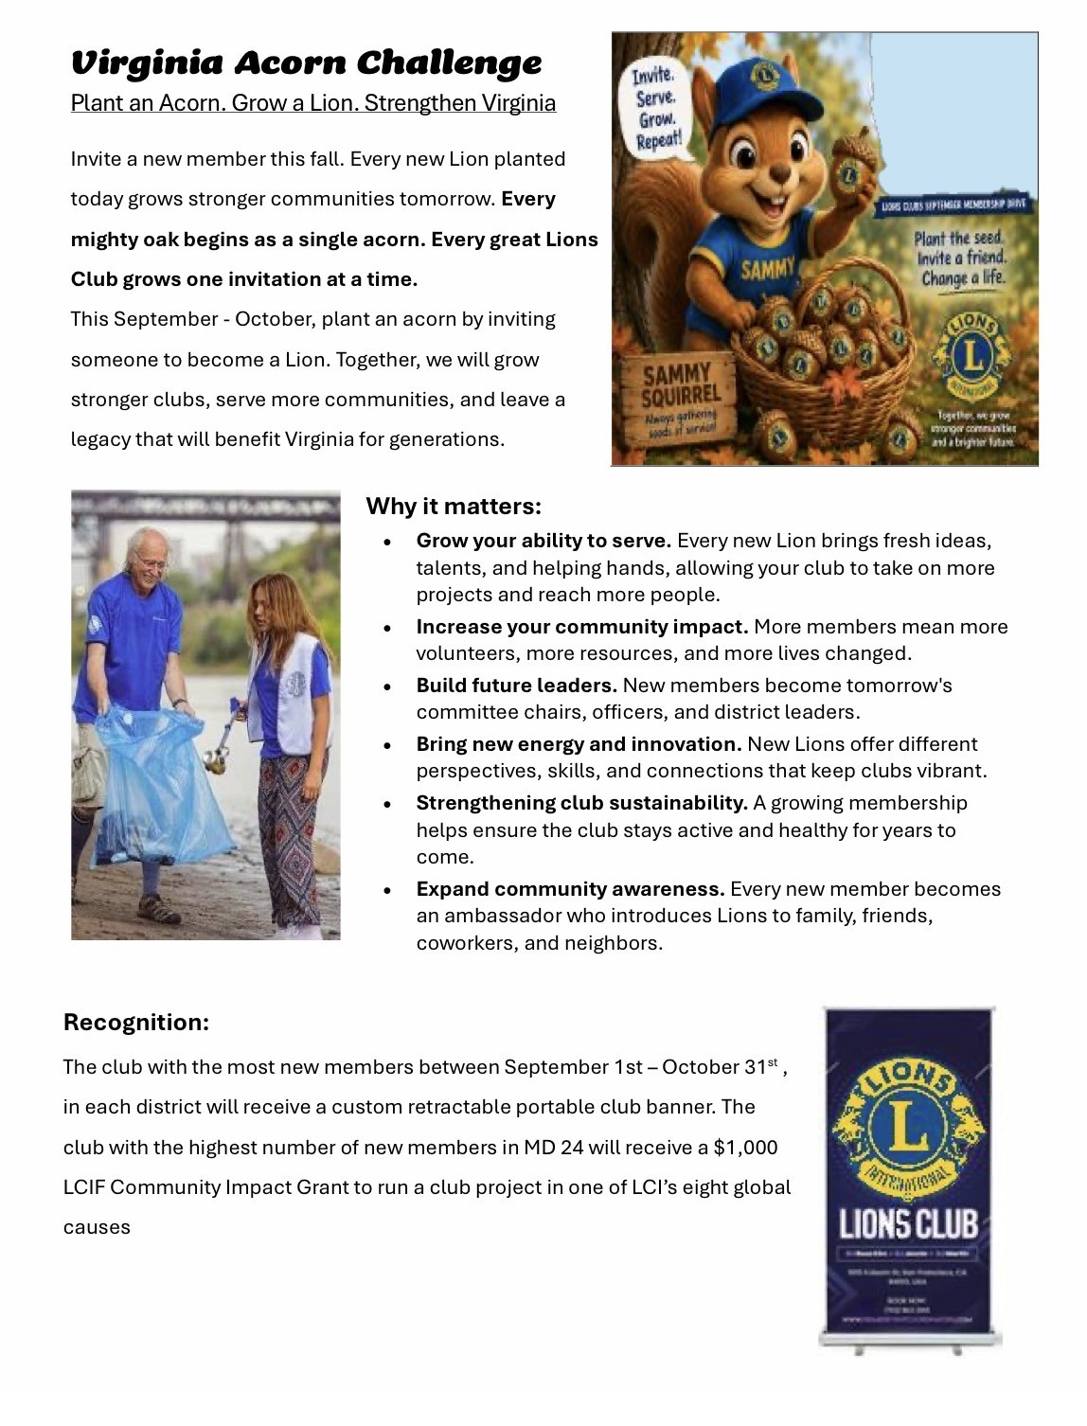
Membership Drive

Slide 24
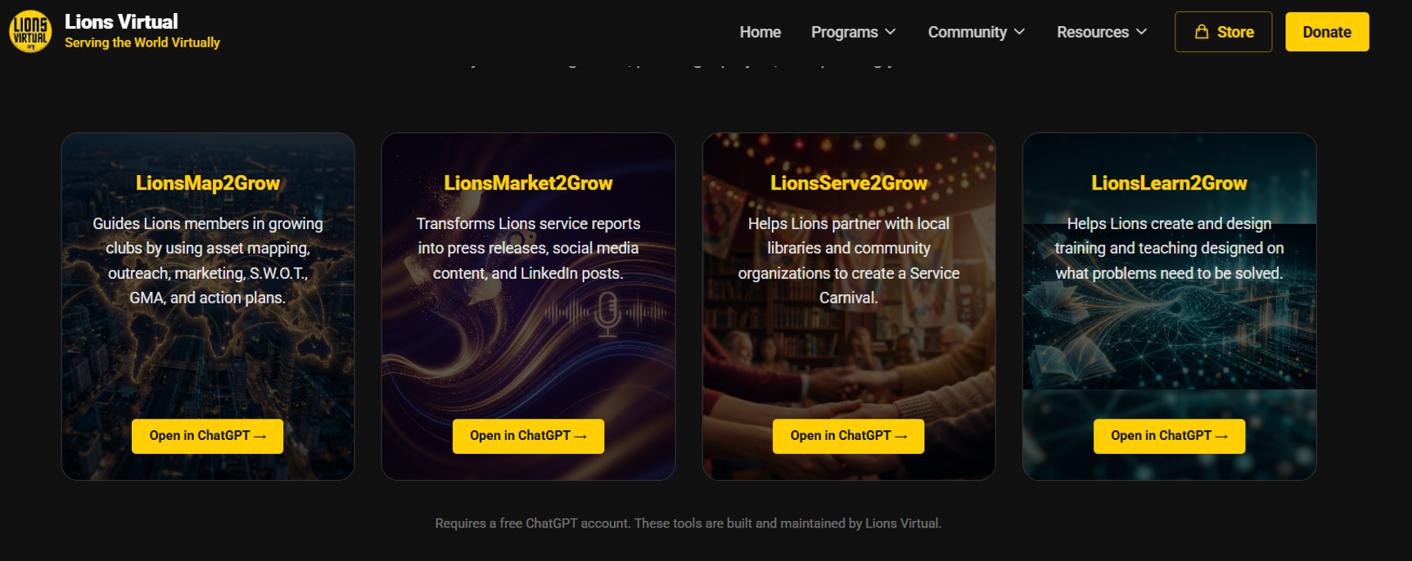
Lions Virtual AI Models & Membership
LionsVirtual.org Models can assist Membership Chairs with writing Membership Plans and Marketing Materials

Slide 25
Lions Virtual: free virtual hub to host hybrid events, orientations, training
  Share success stories and local impact projects globally
  Use breakout rooms for Q&A with prospects during virtual info sessions
  Use ChatGPT to:
    Draft invitation messages or scripts for info sessions
    Generate personalized follow-up messages after events
    Create engaging social media captions or service blurbs
    Brainstorm ideas for themed recruitment campaigns

Slide 26
Walkthrough Example: Using ChatGPT to Support Recruitment
Scenario: You are hosting a virtual open house next month and need help promoting it on social media.
Prompt to ChatGPT:
"Write a friendly, engaging Facebook post inviting community members to a virtual Lions Club open house on June 15 at 7 PM. Highlight the impact of Lions service and invite them to learn how they can get involved.“
ChatGPT Response (example):
🦁 Curious about Lions Clubs? Join us for our Virtual Open House on June 15 at 7 PM! 🌟
Discover how we serve our community, meet our members, and find out how you can make a difference.
💛 Whether you have a few hours a month or a heart full of kindness, there’s a place for you in our pride.
RSVP here 👉 [Zoom Link] #WeServe #LionsKindnessMatters #JoinUs
Copy/paste or adjust for your club’s voice
Ask ChatGPT for versions tailored for Instagram, newsletters, or flyers
AI is your volunteer assistant—just ask!
________________________________________

Slide 27
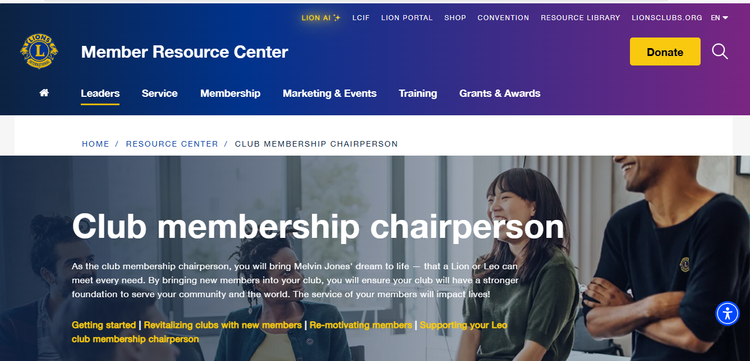
https://www.lionsclubs.org/en/resources-for-members/resource-center/club-membership-chairperson

Slide 28
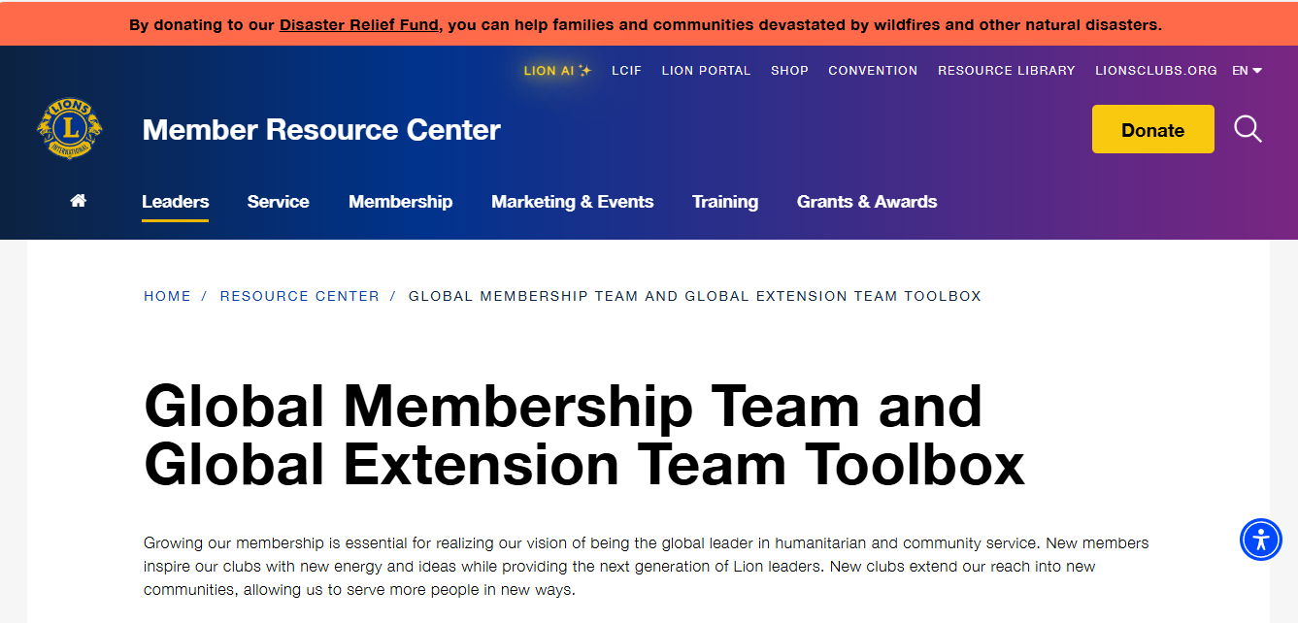
https://www.lionsclubs.org/en/resources-for-members/resource-center/gmt-and-get-toolkit

Slide 29
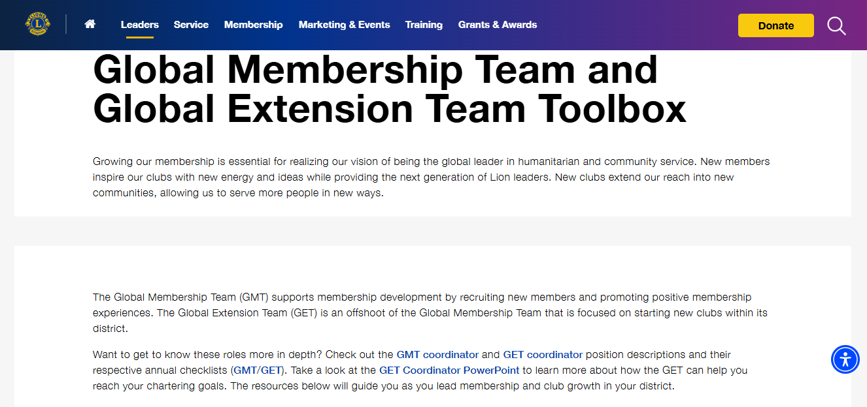
https://www.lionsclubs.org/en/resources-for-members/resource-center/gmt-and-get-toolkit

Slide 30
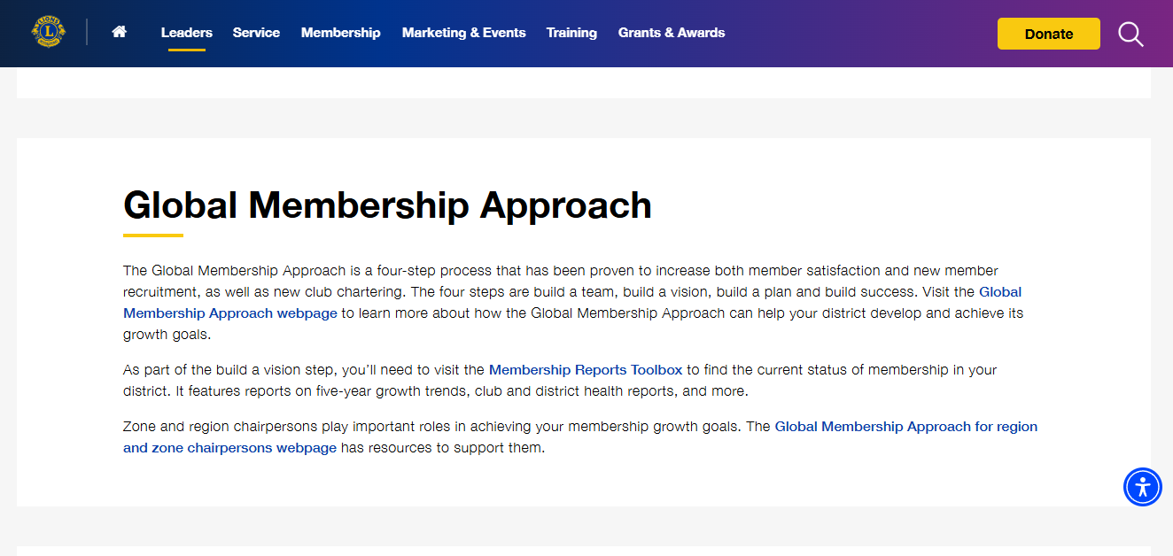
https://www.lionsclubs.org/en/resources-for-members/resource-center/gmt-and-get-toolkit

Slide 31
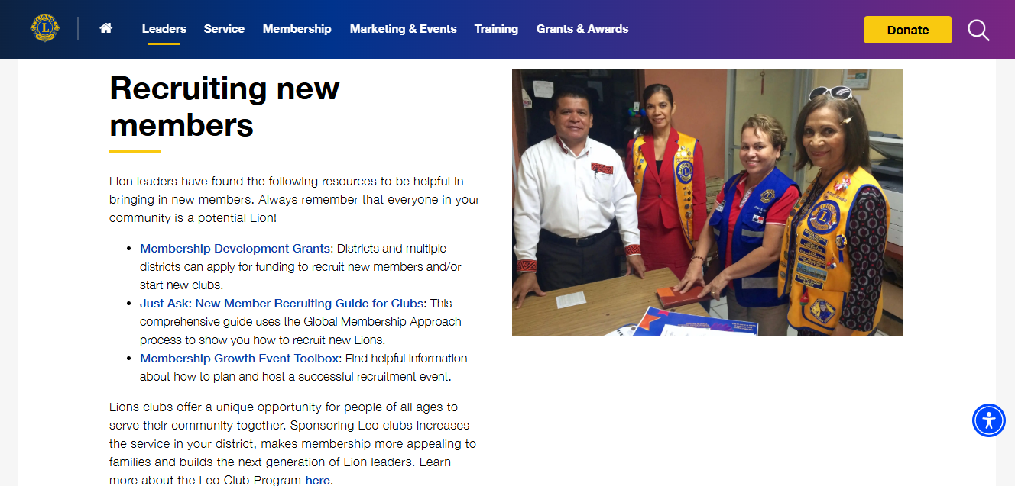
https://www.lionsclubs.org/en/resources-for-members/resource-center/gmt-and-get-toolkit

Slide 32
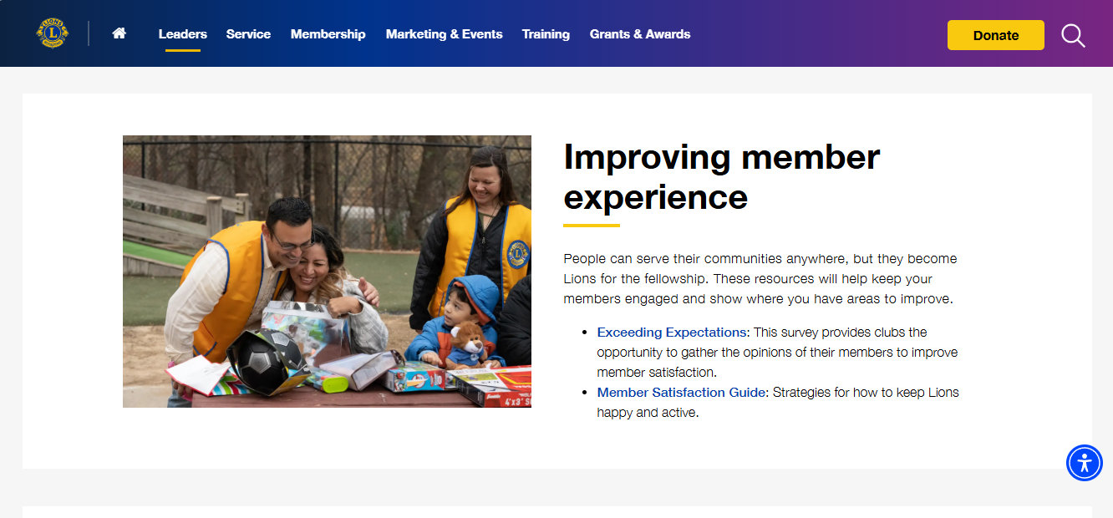
https://www.lionsclubs.org/en/resources-for-members/resource-center/gmt-and-get-toolkit

Slide 33
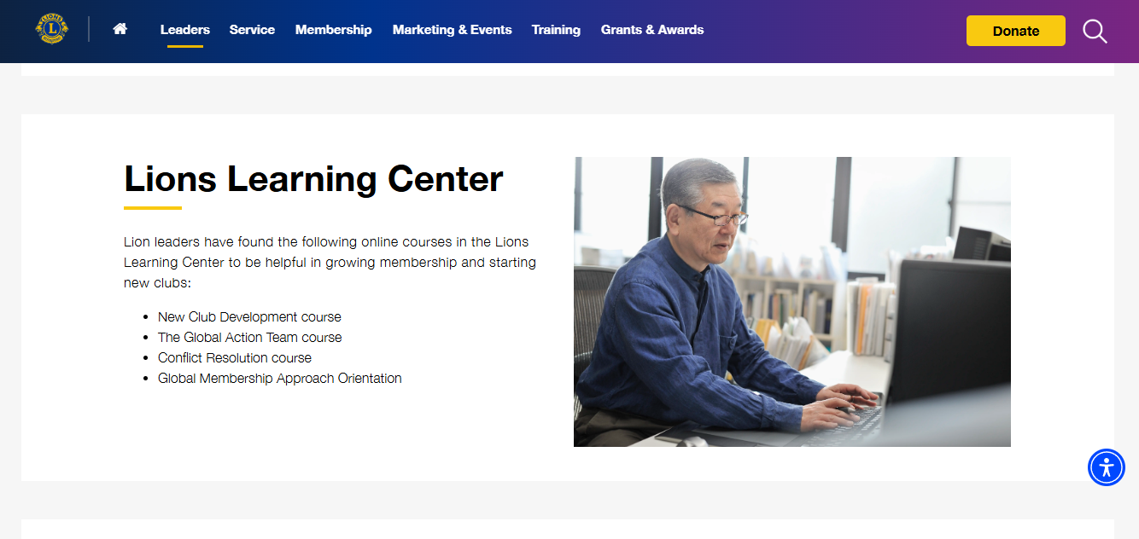

Slide 34
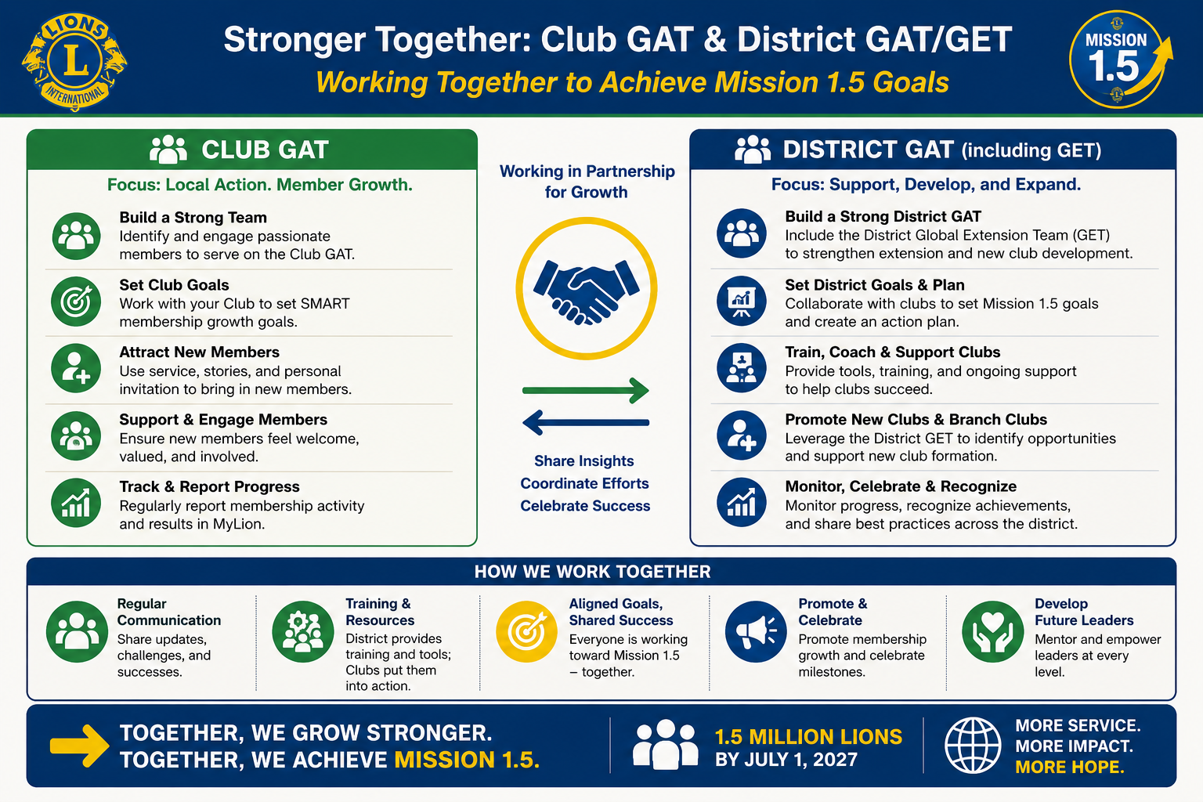

Slide 35
Thank You for your Participation and Dedication
Please share a key takeaway. From today’s session
Please share an action you will take in the next 30 Days. Membership isn’t about numbers—it’s about impact.
Lion David Cropper
Club: Fredericksburg Host
District: 24L
Email: David@CropperHomeSales.com
Phone:540-226-1439
Global Causes
Childhood Cancer – Diabetes – Disaster Relief – Environment - Humanitarian – Hunger – Vision – Youth

