Slide 1


Club Service Chair Training
District Governor 24L Chuck Schwab
GST District 24L Lion Evelyn Marr
August 20, 2026
Global Causes

Slide 2

Global Action Team (GAT)
Where do you fit in?
Club Global Action Team Chairperson (Club President)
GMT
Membership Chairperson
GLT
First Vice President/Leadership Chairperson
GST
Service Chairperson
The “T” in GAT stands for Team, at all organizational levels—Club-to- Zone/District-to-Multiple District-to-Area GATs. Collaboration among GAT Chairs at all levels is highly encouraged to champion the LCI vision to grow membership to 1.5 million Lions worldwide through Mission 1.5. Relevant Lions service is the lynchpin to sustained membership growth.

Slide 3


Lions Clubs Global Causes

Slide 4
Why Service Matters
Service is not just something a Lions club does – It is why we exist.
The best service occurs where community need, member passion, and club capacity come together.
The most powerful recruitment message is often – “Come serve with us and see what Lions do”
What Service project has made your club the most proud – and why?

Slide 5
What are your Responsibilities as
Club Service Chair?
Learn – Club Service Chair e-book, Lions District training, GST Toolbox, the Lions Portal
Participate in Zone and District Meetings
Encourage club members to be involved, contribute new service ideas; ensure that all club members have an opportunity to serve
Collaborate and Partner with Community Organizations to plan needed services in the community
Report all service activities in the Lions Portal!!

Slide 6
The Service Chair’s Role
So, in essence, the Service Chair’s role is to lead, coordinate, connect, encourage, document, report, and celebrate service.
The Service Chair does not have to do all the service. The Service Chair helps create the condition for every Lion to find meaningful ways to serve.
New Members – Get then serving. Get them Involved. Get them connected.
“Every Lion has a service story of why they became a Lion – joining for the service and enjoying fellowship of Lions for years. I hope all the clubs develop the ability to see this necessity of Service. Service builds a club as it enriches a community.” - Lion Julie Balch, Lovettesville Lions

Slide 7




Planning Service - Simple to Complex
Club and Community Needs Assessments
Club Quality Initiative (CQI)
Partner with Community Organizations that have a common goal
Partner with other Clubs in your Zone and/or in the District
Grants available – LCIF, LOVF, Community Impact Grants
Search the web for Community Grants available

Slide 8
Club Quality Initiative (CQI)
The Lions Clubs International Club Quality Initiative (CQI) is a strategic planning framework designed to help local clubs assess their strengths, identify areas for improvement, and pursue new opportunities. It provides a customizable roadmap focusing on four key pillars: membership, service, organizational excellence, and marketing.
The CQI process uses workbooks, surveys, and planning guides to walk club members through a holistic assessment of their current operations. The goal is to develop a shared vision, assess community and member needs, and implement a realistic action plan to ensure the club continues to grow and thrive.

Slide 9
Importance of Reporting Service
Secures Global Partnerships and Grants: LCI relies on data to provide corporate partners and donors with tangible proof of their global footprint. High-quality reporting helps the Lions Clubs International Foundation (LCIF) secure resources and fund future grants.
Preserves Institutional Knowledge: Logging past projects creates a permanent record of what worked. Future club leaders can review these historical metrics to plan better upcoming initiatives.
Drives Membership and Pride: People want to volunteer for organizations that generate verifiable results. Sharing local success metrics puts your club on the community map and attracts new members.

Slide 10
Importance of Reporting Service
Unlocks Official Recognition: Accurate digital documentation is required for individual, club, and district awards, such as the Excellence Awards.
Maintains Club Health Metrics: A lack of digital activity over three consecutive months triggers a red flag on the Club Health Assessment report. Keeping the portal updated proves the club is active and vital.
ONE SMALL SERVICE PROJECT CAN BECOME THE NEXT LCI GLOBAL INITIATIVE.

Slide 11
What Service Do You Report?
Reportable service includes any official activity planned, organized, or sanctioned by a Lions or Leo club that aligns with the organization's mission to serve local and global communities.
To successfully submit a past service project, fundraiser, or donation in the Lions Portal, authorized officers—such as the Service Chairperson, Secretary, or President—must fill out three core metrics:
People served: The total number of community members impacted.
Total volunteers: The count of participating Lions, Leos, and non-member volunteers.
Total volunteer hours: The combined time dedicated to the event.

Slide 12
What Service Do You Report?
There are 4 Activity Types In the Lions Portal - The Lions Portal framework defines reportable activities under four specific classifications:
Service Projects: Hands-on community work, such as hosting diabetes screenings, cleaning up public parks, or organizing vision clinics
Fundraisers: Events organized specifically to raise money for charity, like a charity dinner or benefit auction
Donations: Directly giving accumulated funds or physical goods to individuals, community projects, or the Lions Clubs International Foundation (LCIF).
Meetings: Official club meetings, district events, or administrative time. (The hours spent planning and reporting service are considered reportable administrative hours).

Slide 13
What Makes an Activity Reportable?
To be submitted into the portal, an activity must meet three criteria:
Club-Sanctioned: The project must be organized or approved by the club, district, or multiple district.
Measurable: You must be able to report the number of volunteers, total hours spent (including planning), and people served.
Completed: The activity's end date must be in the past before it can be formally marked as "reported" to be submitted into the portal, an activity must meet three criteria:

Slide 14
What is NOT Reportable?
The portal strictly excludes individual good deeds performed outside of a Lions Club framework
INDIVIDUAL LION SERVICE COUNTS
A project does not have to involve the entire club to represent meaningful Lions service. When an individual Lion performs legitimate service in the community, the club may recognize the activity and include it in its service reporting.
Example: A Lion spends four hours volunteering at a community food pantry serving 75 people.
The club could report:
Lions Participating: 1
Volunteer Hours: 4
People Served: 75

Slide 15
Lions Weeks of Service
Vision – October 8-18, 2026: Centered around eye health, avoiding preventable blindness, and celebrating World Sight Day (October 8) and International White Cane Day (October 15).
Youth – February 13-21, 2027: Focused on youth mentorship, empowerment, and developing programs that invest in the next generation.
Environment - May 29-June 6, 2027: Dedicated to planet preservation, sustainable initiatives, and celebrating World Environment Day.

Slide 16
Why Participate in Lions International
Service Weeks and Initiatives?
Provide ready-made project ideas.
Create excitement around service.
Connect the club to the global Lions mission.
Give members a common purpose.
Encourage collaboration with other clubs.
Increase visibility.
Create opportunities for social media and community promotion.
Support recognition opportunities.

Slide 17
District Service Projects
A Ball for All – Initiated by 24L, the project provides a soccer-like ball with internal bells for every blind child in Virginia.
Listen Up! Project - New MD24 project, partnering with the Virginia School for the Deaf and blind, to do hearing screening on preschool children to detect and treat Late Onset Hearing Loss
Disaster Response – Planning, training, and preparations for a community disaster.
Peace Poster / Essay Contest – “Harmony in Humanity” is this year’s theme. Club submissions need to be sent to the DG by 15 November.
Lions of Virginia Bland Music Scholarship Competition

Slide 18
The Service Chair should:
Know the upcoming Lions International service initiatives.
Put them on the club calendar early.
Share them with the Board and membership.
Encourage members to participate.
Adapt the initiative to meet a local community need.
Promote the project.
Report the service promptly.
Look for recognition and award opportunities.
Think globally. Serve locally.

Slide 19
Community Visibility Through Service
Before each project, ask:
How will people know Lions are doing this?
Use:
Social media.
Community calendars.
Partner communications.
Local media.
Club websites.
Member networks.

Slide 20
Community Visibility Through Service
After the project, tell the story. A strong service post answers:
What was the community need?
What did Lions do?
Who benefited?
What was the impact?
How can others get involved?
Do not simply post a picture of Lions standing together. Tell the story of why the service mattered.

Slide 21
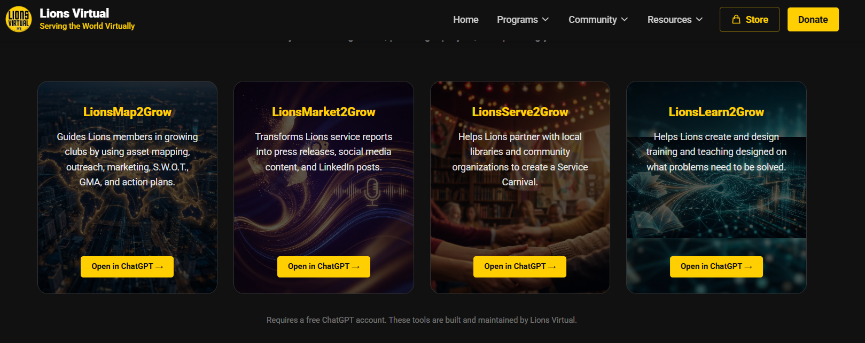
Lions Virtual AI Models & Service
LionsVirtual.org Models can assist Service Chairs with planning, collaboration, executing and reporting Service

Slide 22

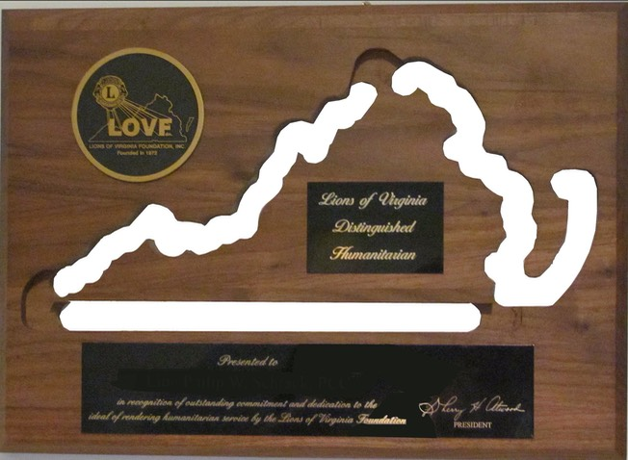

Remember to Celebrate Service and Your Successes!!
Member Awards – Lion of the Year; Recommendations to the District Governor
Club Excellence Award
LCI Kindness Matters Service Award (KMSA)
LOVF Humanitarian Award

Slide 23
Kindness Matters Service Award Deadlines
The primary submission deadline for the Kindness Matters Service Award at the club level is February 28.
The evaluation and filtering process moves through several distinct deadlines as the nomination progresses up the organizational ladder:
Nomination Timeline
  February 28: Deadline for Lions and Leo Clubs to submit their finalized nomination form to their District.
  March 31: Deadline for the District Cabinet (D-GST coordinators) to select one winning project to move forward.
  April 30: Deadline for the Multiple District Council of Governors (MD-GST coordinators) to vote and submit their single finalist to Lions International.
Key Rules for the 2026–2027 Term
  Project Window: Service projects must have taken place between July 1, 2025, and February 27, 2027.
  Portal Entry: Your project must be fully logged and reported within the official Lion Portal before submitting the nomination.

Slide 24
Why Recognition Matters
Recognition can:
  Celebrate members’ efforts.
  Encourage continued participation.
  Create pride in the club.
  Highlight successful projects.
  Increase community awareness.
  Encourage clubs to participate in special initiatives.
  Give members a sense that their work matters.

Slide 25
Service Chair Best Practices
Create a simple Service Recognition Calendar that identifies:
Major Lions International Service Weeks.
District service initiatives.
Club signature projects.
Reporting deadlines.
Award and recognition opportunities.
Social media and publicity opportunities.
Do not wait until the end of the year to discover that your club completed an outstanding project that could have been recognized. Know the opportunities early and plan accordingly.

Slide 26
Supplemental Information
Action Item
Monitor the BLOG on valions.org for updates on LCI and District GAT and Service Posts
Useful Links
GAT Facebook page: https://www.facebook.com/share/g/1EnBAQKVgn/
District 24-L Club Officer Reference Guide
https://lionsdistrict24l.org/wp-content/uploads/2025/07/Officer-Reference-Guide.pdf

Slide 27
Personal Action Plan
1. One community need I want to learn more about:
2. One way I will gather member input or identify member passions:
3. One action I will take to improve our service reporting, participation, or visibility:
“My responsibility is not simply to schedule service projects. I help my club identify where we can make the greatest difference, engage our members in meaningful service, connect with the larger Lions mission, accurately report our impact, celebrate our accomplishments, and use service to strengthen our club and community.”

Slide 28

International President Mark Lyon’s
Remarks on Service
Click on picture to play video

Slide 29
Questions?
Thank You!!

